Slide 1
Comparative Evaluation of Transfer Learning Strategies for AI-Generated Face Detection using EfficientNetB0, ResNet50, and MobileNetV2 Rismiyati*, Herlina*, I Gede Bintang Arya Budaya*
Computer Vision Lanjut
Program Studi Doktor Ilmu Komputer

Slide 2
Introduction - Research Problem
AI development brings major benefits but also serious risks, including unethical misuse.
DeepFake technology creates highly realistic synthetic images/videos that are difficult to distinguish from real ones.
DeepFake cases are increasing in Indonesia, affecting public figures and contributing to cyberbullying, defamation, and political manipulation.
Detecting DeepFakes is challenging; CNN-based approaches help extract subtle visual artifacts.
This study develops a DeepFake detection system by comparing EfficientNetB0, ResNet50, and MobileNetV2.
Goal: provide insights on balancing detection accuracy and computational efficiency.
Notes:
Kanker merupakan salah satu penyebab kematian tertinggi di dunia → deteksi dini sangat penting untuk meningkatkan peluang hidup pasien.
Citra medis (CT, MRI, PET, Ultrasound, Dermoscopy) digunakan untuk mengidentifikasi tumor atau kelainan jaringan tanpa operasi.
Namun, analisis manual citra oleh dokter sering kali memakan waktu, subjektif, dan kurang akurat karena adanya noise, blur, dan perbedaan pencahayaan antar alat.
Diperlukan sistem otomatis berbasis pengolahan citra (Computer Vision) untuk:
Menyegmentasi area yang dicurigai tumor,
Menarik fitur penting (tekstur, warna, bentuk), dan
Mengklasifikasi citra sebagai normal atau abnormal.
Penelitian ini mengusulkan metode Modified Block-Based Three Channel Hybrid Segmentation yang dikombinasikan dengan feature extraction, ReliefF selection, dan ELM classifier
→ untuk mendeteksi tumor secara otomatis, cepat, dan akurat pada berbagai jenis citra medis.

Slide 3
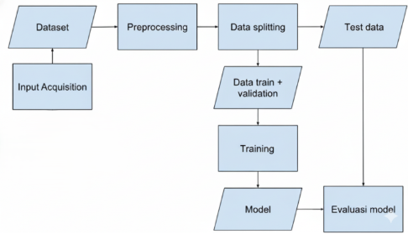
Methods

Slide 4
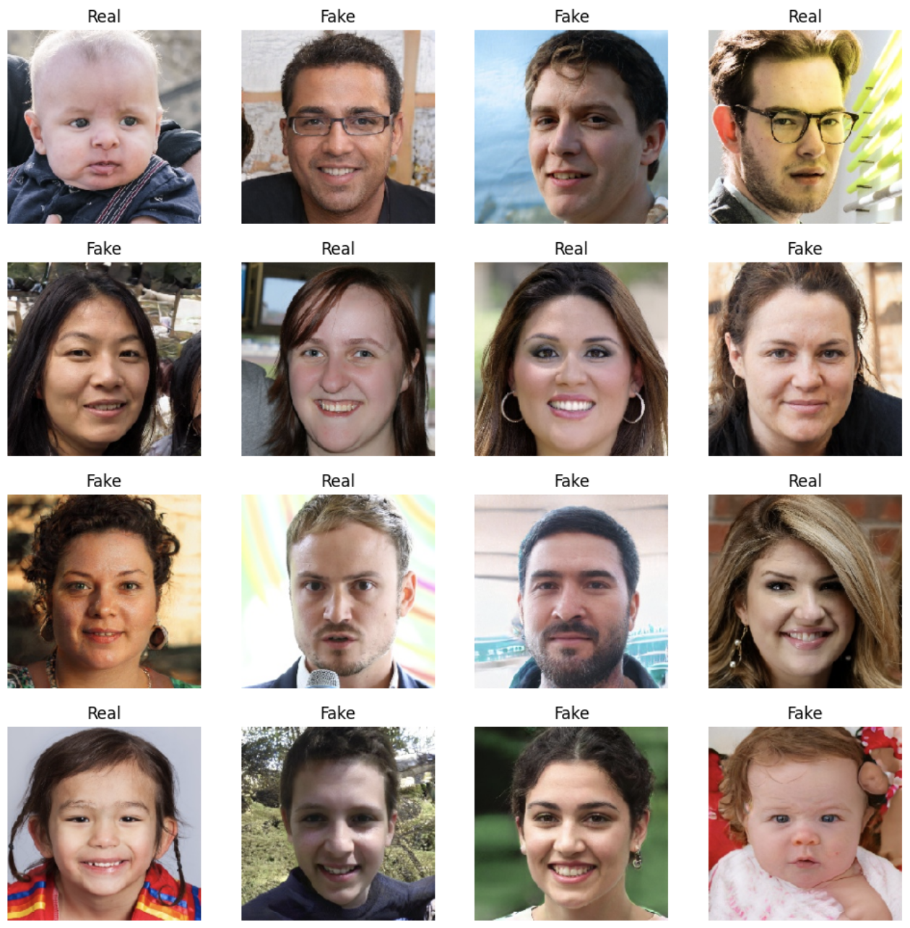
Dataset Details
Dataset source :
Kaggle 140K Real and Fake Faces Public Dataset
Size : 256 x 256 px
Num of classes : 2 classes (real & fake)
Data splitting
No | Dataset | Total
1 | Training | 20,000
2 | Validation | 2,000
3 | Testing | 2,000

Slide 5
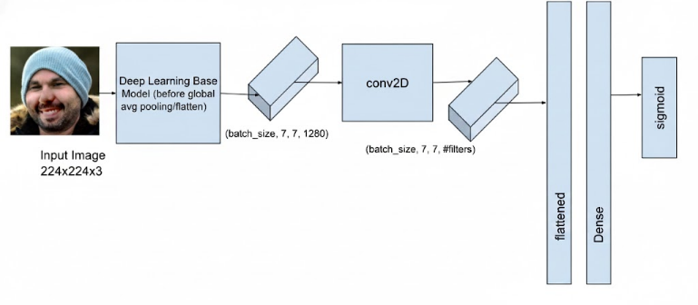
The Proposed Training Model
The base models used in this experiment are EfficientNetB0, ResNet50 and MobileNetV2.
Experiment scenario:
Determine the structure of dense layer: is performed with ResNet50 base layer
neuron number (256,512)
drop out of (0.3,0.5,0.7)
Determine the structure of convolution layer
number of kernel (256,512)
kernel size ([3,3], [7,7])
Determine the impact of fine tune to the model
No fine tuning
50% fine tuning performed

Slide 6
Result –ResNet50
No | Model Name | Accuracy (%) | Precision (%) | Recall (%) | F1-Score (%)
1 | R_noFT_D256_DO0.3 | 68.25 | 68.53 | 67.50 | 68
2 | R_noFT_D256_ DO0.5 | 66.80 | 67.07 | 66.00 | 67
3 | R_noFT_D256_ DO0.7 | 68.90 | 69.09 | 68,40 | 69
4 | R_noFT_D512_DO0.3 | 68.75 | 67.28 | 73.00 | 70
5 | R_noFT_D512_ DO0.5 | 61.85 | 57.56 | 90.20 | 70
6 | R_noFT_D512_ DO0.7 | 67.90 | 68.53 | 66.20 | 68
7 | R_noFT_C256_3x3_D256_DO0.7 | 72.8 | 73.26 | 71.8 | 72.5
8 | R_noFT_C256_7x7_D256_DO0.7 | 78.0 | 78.9 | 76.3 | 77.6
9 | R_noFT_C512_3x3_D256_DO0.7 | 73.75 | 74.3 | 72.6 | 73.4
10 | R_noFT_C512_7x7_D256_DO0.7 | 74.3 | 85.9 | 58.1 | 69.33
11 | R_FT50_D256_DO0.7 | 84.5 | 85.2 | 84.1 | 84.6
12 | R_FT50_C256_3x3_D256_DO0.7 | 90.05 | 92.4 | 88.25 | 90.27
13 | R_FT50_C256_7x7_D256_DO0.7 | 87.9 | 88.6 | 88.2 | 88.0

Slide 7
Result –EfficientNet
No | Model Name | Accuracy (%) | Precision (%) | Recall (%) | F1-Score (%)
1 | E_noFT_C256_3x3_D256_DO0.7 | 93.35 | 91.40 | 95.70 | 93.50
2 | E_noFT_C256_7x7_D256_DO0.7 | 92.95 | 93.08 | 92.80 | 92.94
3 | E_noFT_C512_3x3_D256_DO0.7 | 93.35 | 92.96 | 93.80 | 93.38
4 | E_noFT_C512_7x7_D256_DO0.7 | 92.55 | 91.51 | 93.80 | 92.64
5 | E_FT50_C256_3x3_D256_DO0.7 | 91.65 | 91.36 | 92.00 | 91.68
6 | E_FT50_C256_7x7_D256_DO0.7 | 92.40 | 92.57 | 92.20 | 92.38
7 | E_FT50_C512_3x3_D256_DO0.7 | 91.75 | 89.95 | 94.00 | 91.93
8 | E_FT50_C512_7x7_D256_DO0.7 | 92.50 | 92.33 | 92.70 | 92.51

Slide 8
Result –MobileNet
No | Model Name | Accuracy (%) | Precision (%) | Recall (%) | F1-Score (%)
1 | M_noFT_D256_ DO0.3 | 83.00 | 83.21 | 83.00 | 82.97
2 | M_noFT_D256_ DO0.5 | 81.95 | 81.95 | 81.95 | 81.95
3 | M_noFT_D256_ DO0.7 | 82.45 | 82.45 | 82.45 | 82.45
4 | M_noFT_D512_ DO0.3 | 81.45 | 81.47 | 81.45 | 81.45
5 | M_noFT_D512_DO0.5 | 81.95 | 81.97 | 81.95 | 81.95
6 | M_noFT_D512_ DO0.7 | 81.45 | 81.49 | 81.45 | 81.44
7 | M_noFT_C256_3x3_D256_DO0.7 | 83.5 | 83.65 | 83.50 | 83.48
8 | M_noFT_C512_3x3_D256_DO0.7 | 84.05 | 84.11 | 84.05 | 84.04
9 | M_noFT_C256_7x7_D256_DO0.7 | 83.5 | 83.69 | 83.50 | 83.48
10 | M_noFT_C512_7x7_D256_DO0.7 | 85.35 | 85.55 | 85.35 | 85.33
11 | M_FT50_C256_3x3_D256_DO0.7 | 90.85 | 91.06 | 90.85 | 90.84
12 | M_FT50_C512_7x7_D256_DO0.7 | 91.50 | 92.19 | 91.50 | 91.47

Slide 9
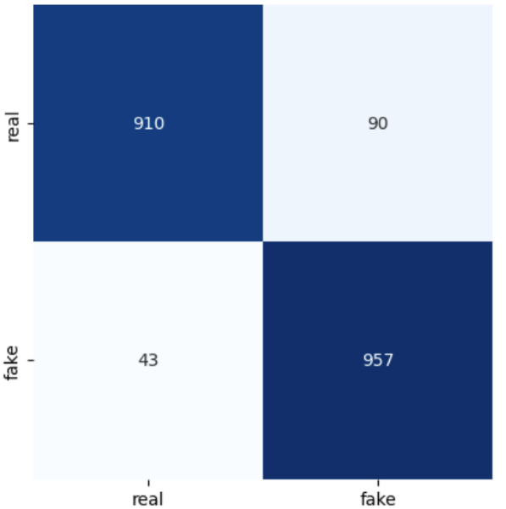
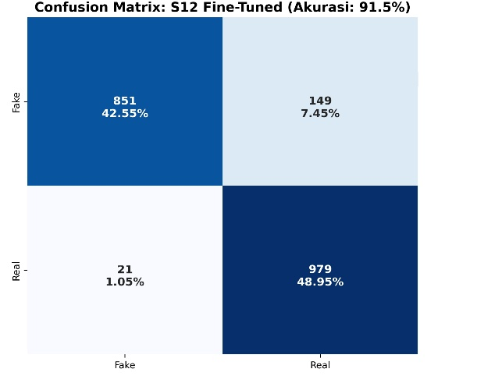
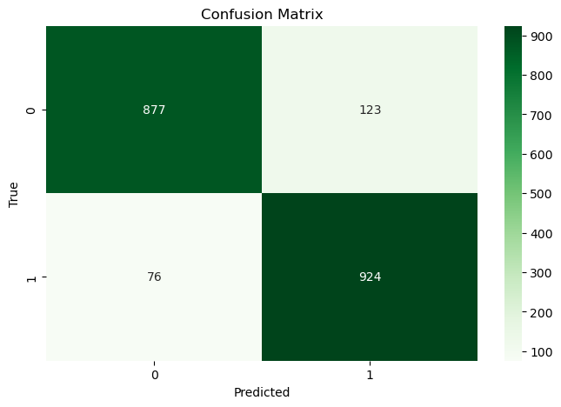
Results – Comparison 3 models
No | Model | Configuration | Accuracy (%) | Precision (%) | Recall (%) | F1-Score (%)
1 | EfficientNetB0 | Hybrid Conv 256 (3x3) | 93.35 | 91.40 | 95.70 | 93.50
2 | MobileNetV2 | Fine-Tune 50% + Hybrid Conv 256 (3x3) | 91.50 | 92.19 | 91.50 | 91.47
3 | ResNet | Fine-Tune 50% + Hybrid Conv 512 (7x7) | 90.05 | 92.4 | 88,25 | 90.27
EfficientNetB0
MobileNetV2
ResNet

Slide 10
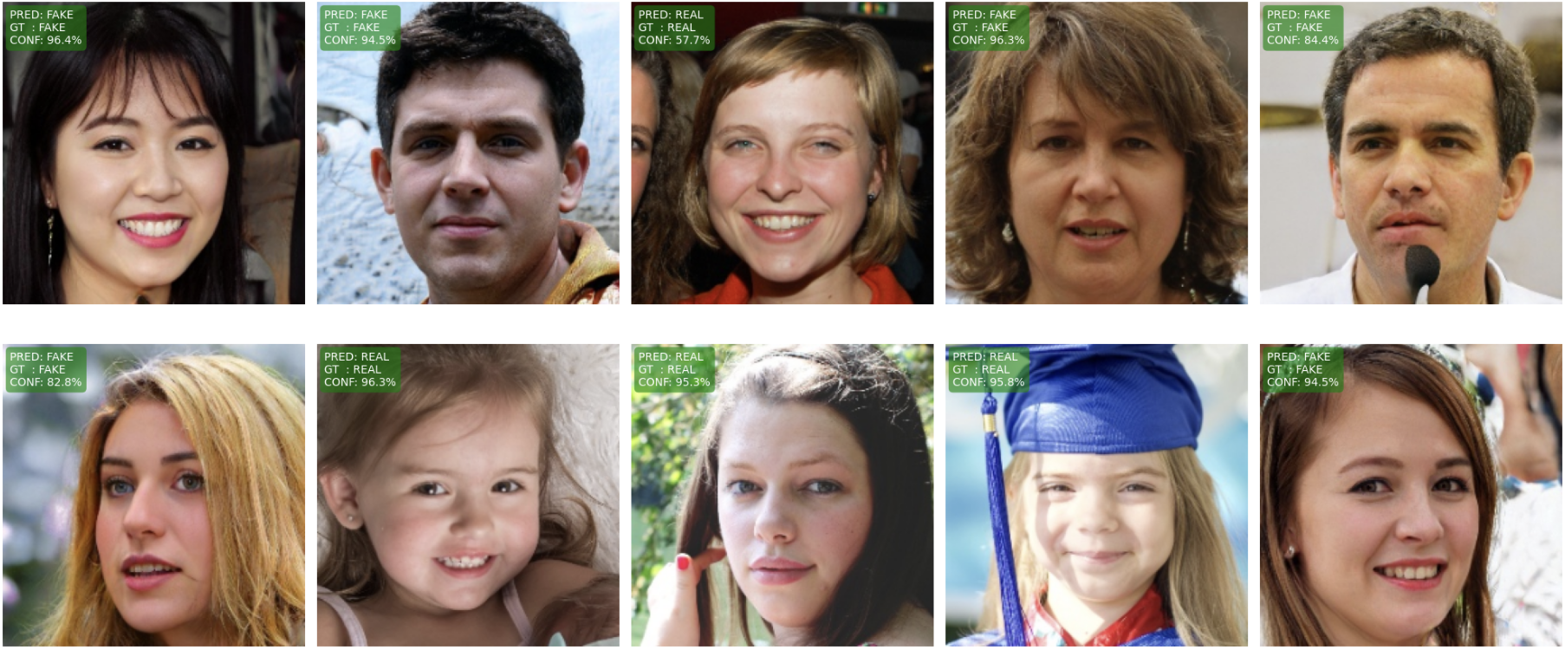
Test Results – Best Model

Slide 11
Conclusion
EfficientNetB0 + 3×3 Conv Head (256 filters) delivers the best performance with an F1-Score of 93.50%.
Adding a small 3×3 convolutional layer at the final stage is more effective for capturing subtle deepfake artifacts than standard dense-only classification heads or larger convolution kernels (e.g., 7×7)
Fine-tuning boosts MobileNetV2 and ResNet50, but EfficientNetB0 remains the most stable and efficient.
Recommended model: EfficientNetB0 with custom 3×3 conv head for the best accuracy–robustness balance.

Slide 12

THANK YOU
LOCALLY ROOTED, GLOBALLY RESPECTED
ugm.ac.id

